Slide 1
Sentiment Analysis in R for a Customer Support Dataset from Twitter and Visualization in Tableau

Slide 2
Contents
Dataset Information
Data Cleaning & Text Mining in R
Sentiment Analysis using several lexicon packages
Visualization in tableau
Sharing New Learnings
Team Reflection
References

Slide 3
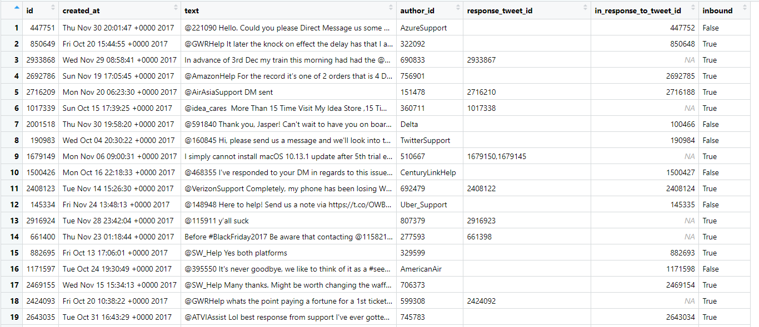
Dataset Information
cs_data2
CUSTOMER SUPPORT CONVERSATIONS FROM TWITTER

Slide 4

Text Mining and Sentiment Analysis in R

Slide 5
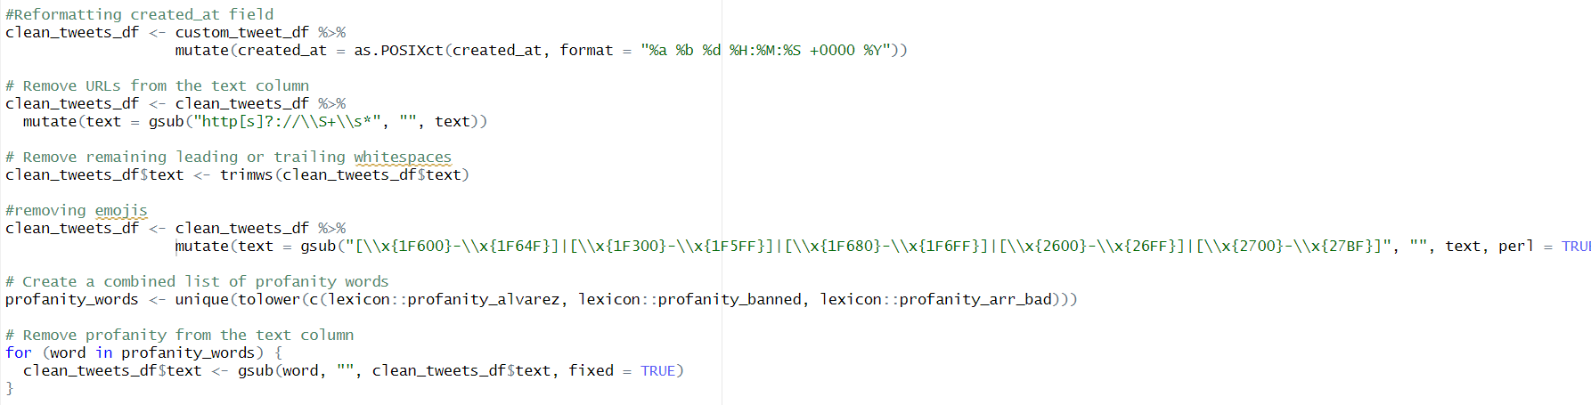
Cleaning the data
1
2
3
4
Reformatting
created_at field
Removing
URLs from text column
Removing
emojis
Removing
Profanity words
Code Snippet:
Used for loop to update DF, instead of just filtering while vsisualization

Slide 6
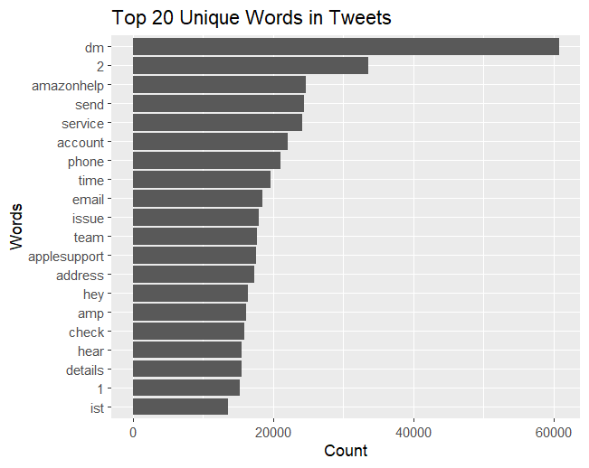
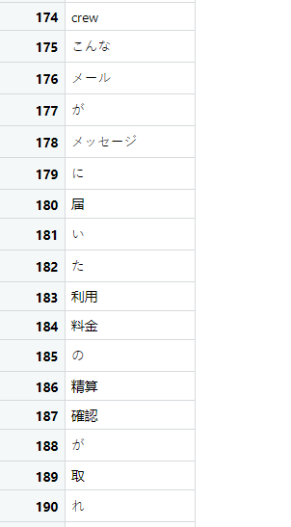
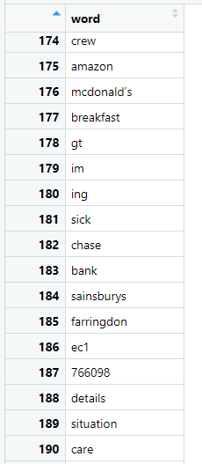
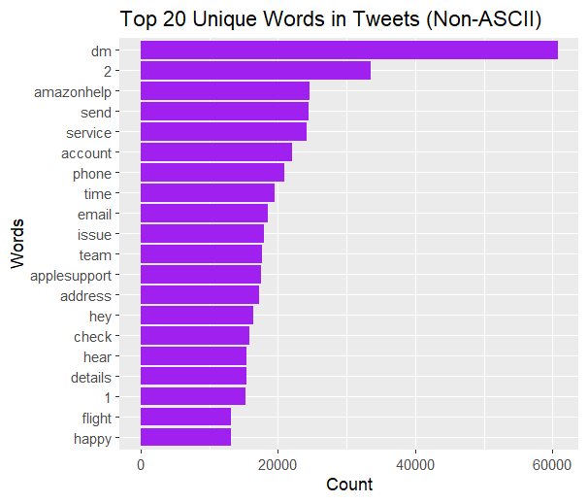
Full list vs non- ASCII list
Non-ASCII words present in the list
Data Frames
Removed
words_in_tweets_df
non_ASCII_df

Slide 7
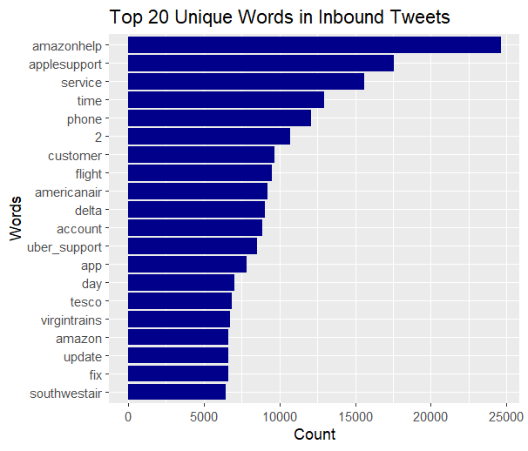
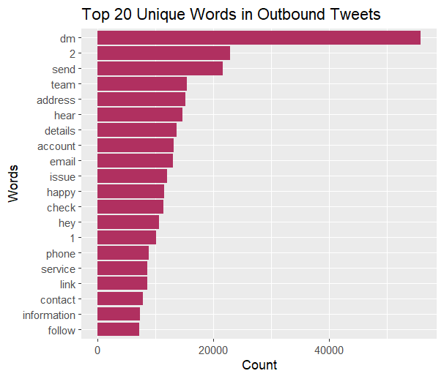
Inbound vs Outbound tweets
Inbound Tweet focuses on support seeking interaction, whereas
Outbound Tweet reveals support providing communication

Slide 8
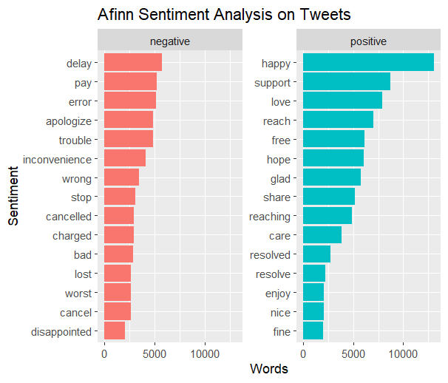
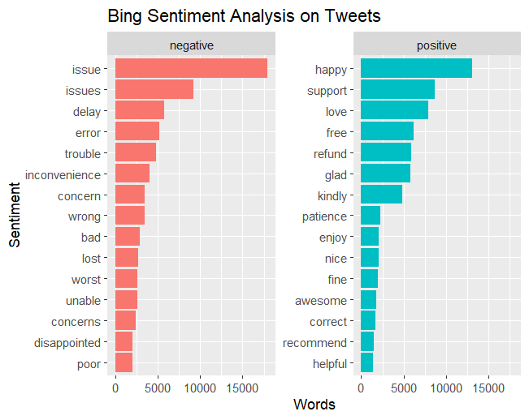
Afinn vs Bing Analysis
Higher negative words frequency captured by Bing

Slide 9
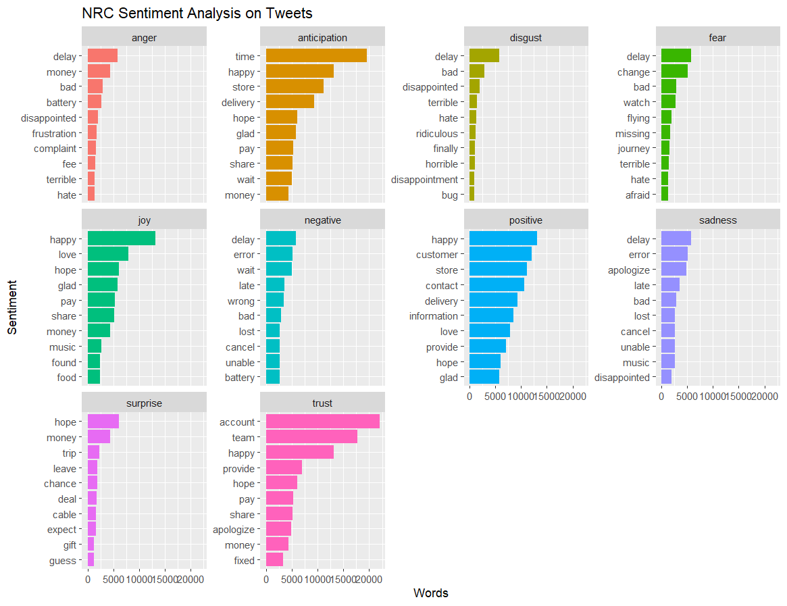
NRC Sentiment Analysis
Richer emotional spectrum
Word-Level Analysis
Contextual Understanding

Slide 10
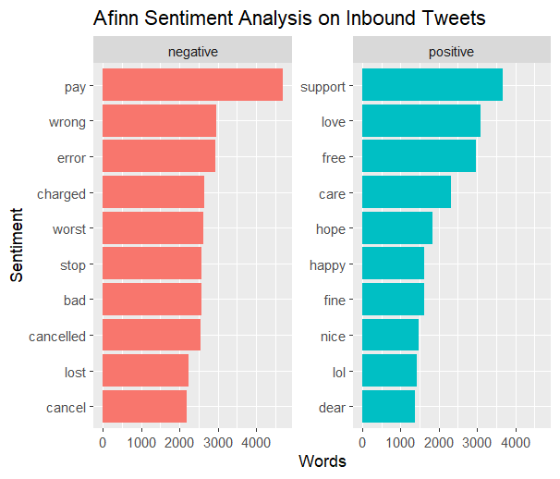
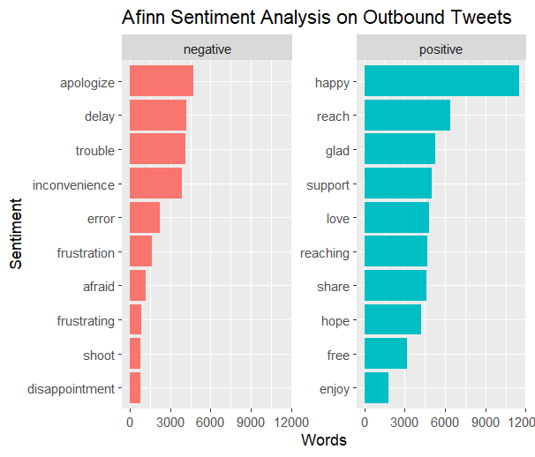
Afinn:: Inbound vs Outbound Analysis
Outbound tweets have low negative words and very high positive words frequency compared to Inbound Tweets

Slide 11
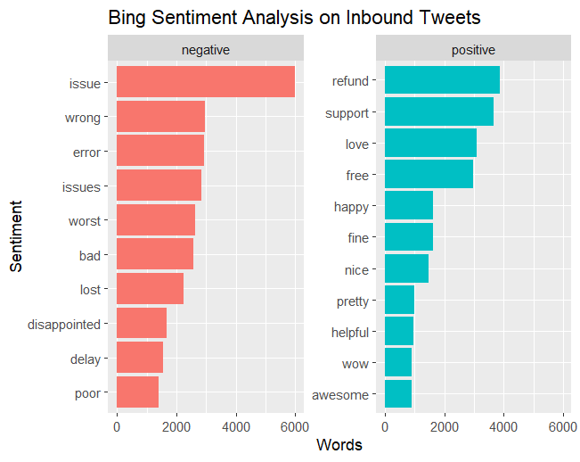
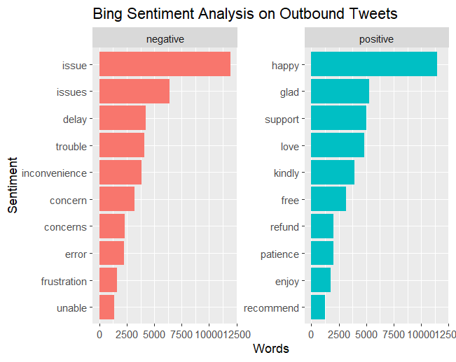
Bing:: Inbound vs Outbound Analysis
Inbound tweets highlight customer needs and problems.
Outbound tweets emphasize responsiveness and positive engagement.

Slide 12
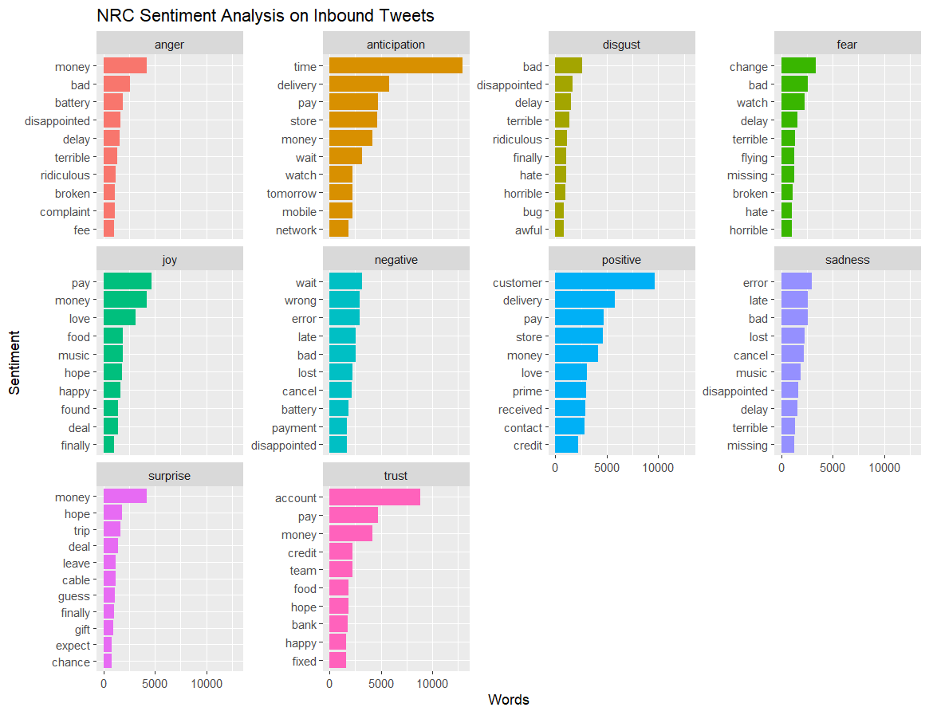
NRC:: Inbound Tweets
More negative sentiment than positive sentiment
Words like “disappointed,” “terrible,” and “bad” dominate inbound tweets.

Slide 13
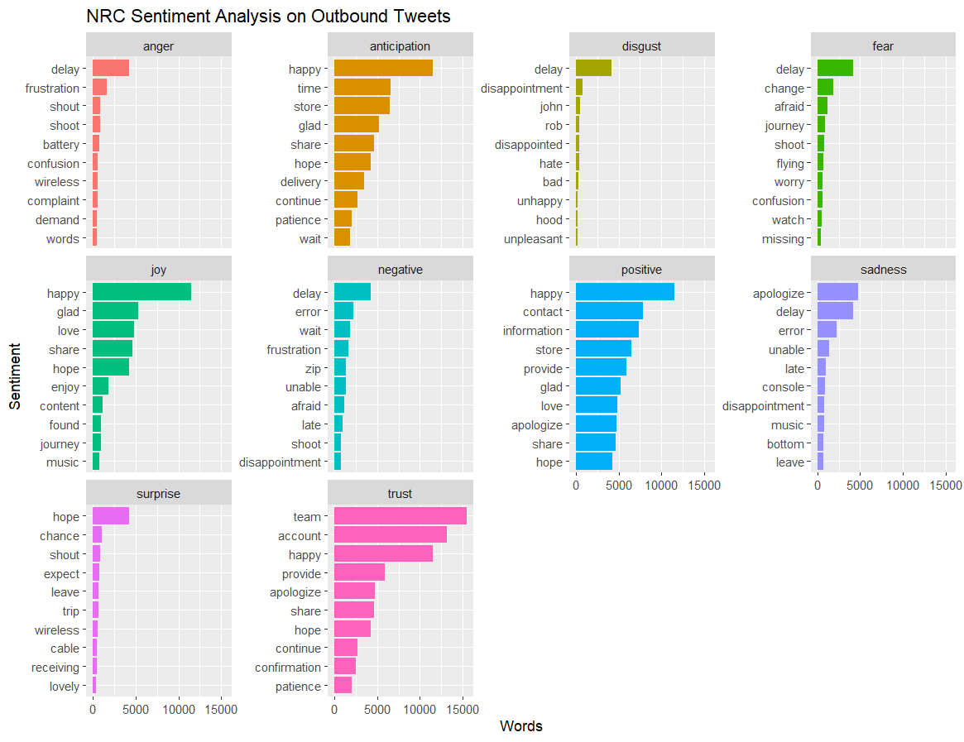
NRC:: Outbound Tweets
More positive sentiment than Negative sentiment
Positive words like “happy,” “apologize,” and “glad” dominate inbound tweets.

Slide 14
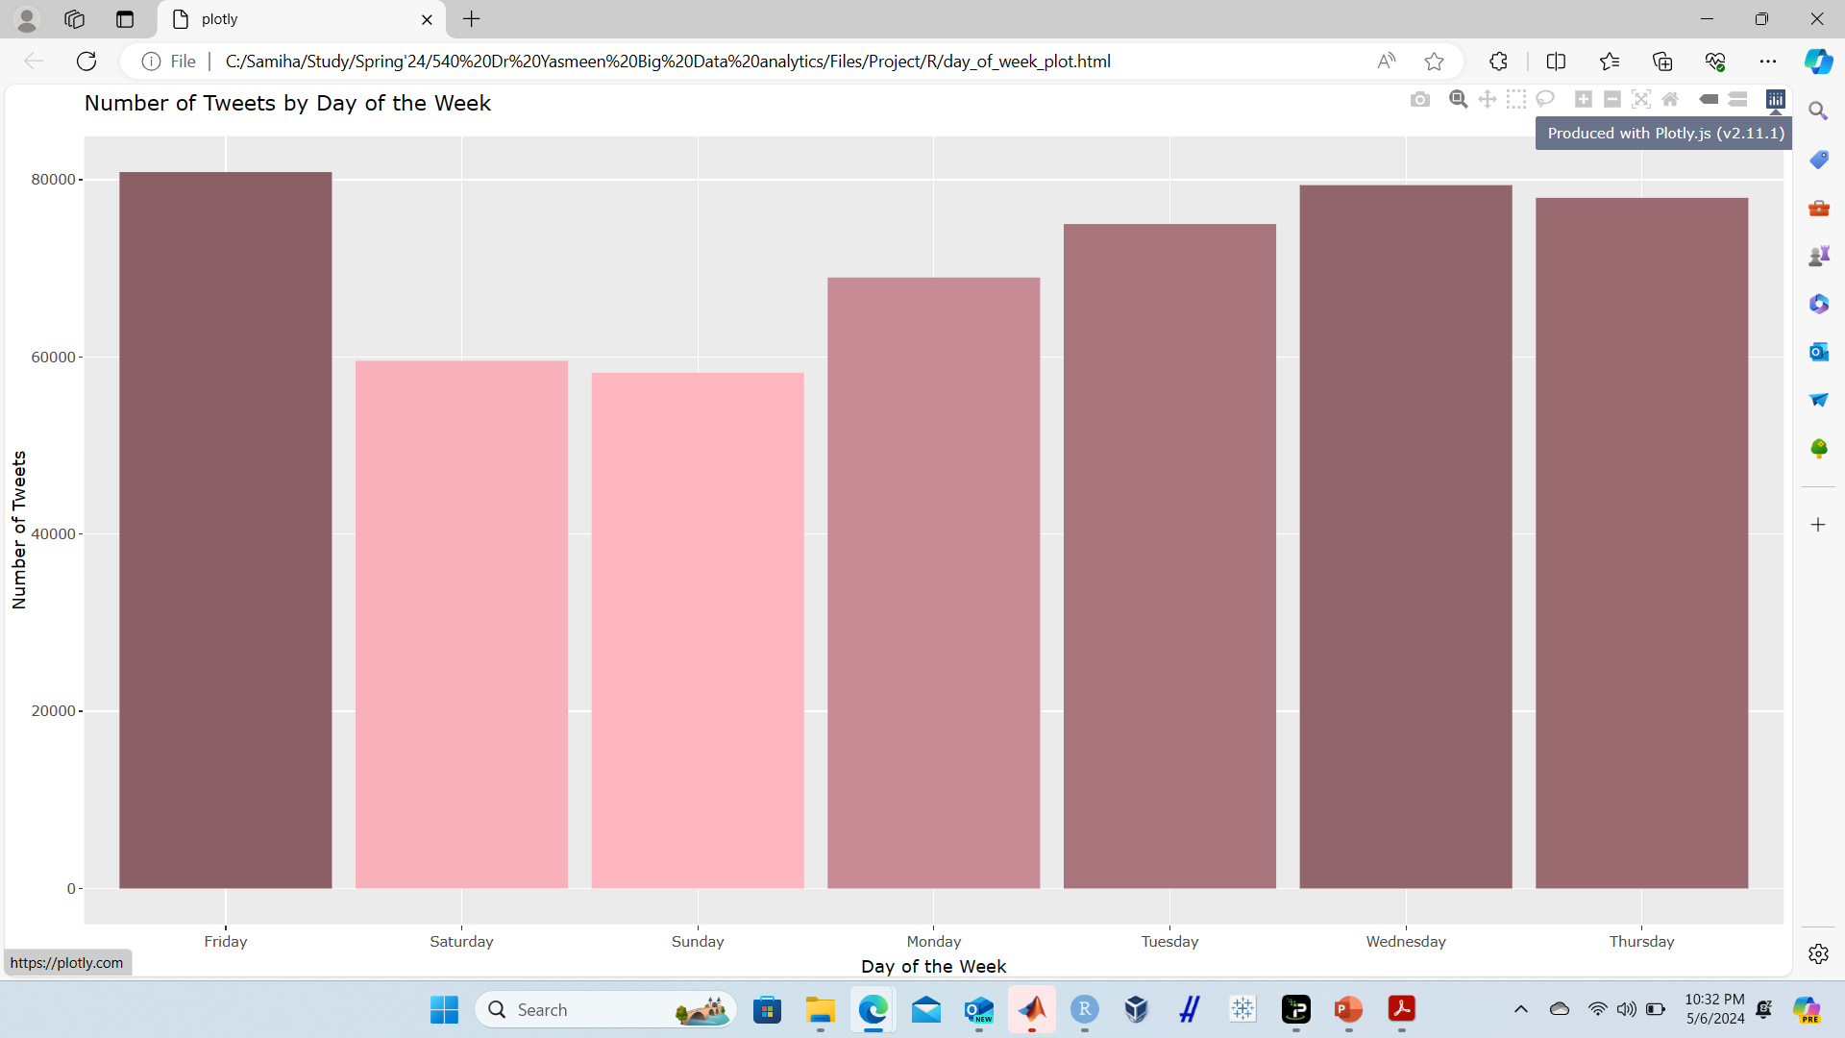
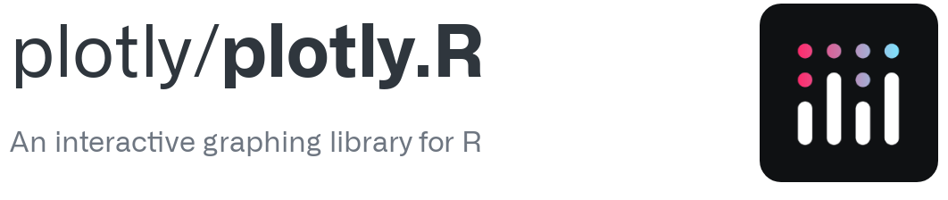
Number of tweets by day of week
Leveraged Plotly to generate an interactive HTML file for dynamic data visualization
Low tweets on weekends Word-Level Analysis
Almost gradual increase after weekend

Slide 15

Visualization in Tableau

Slide 16
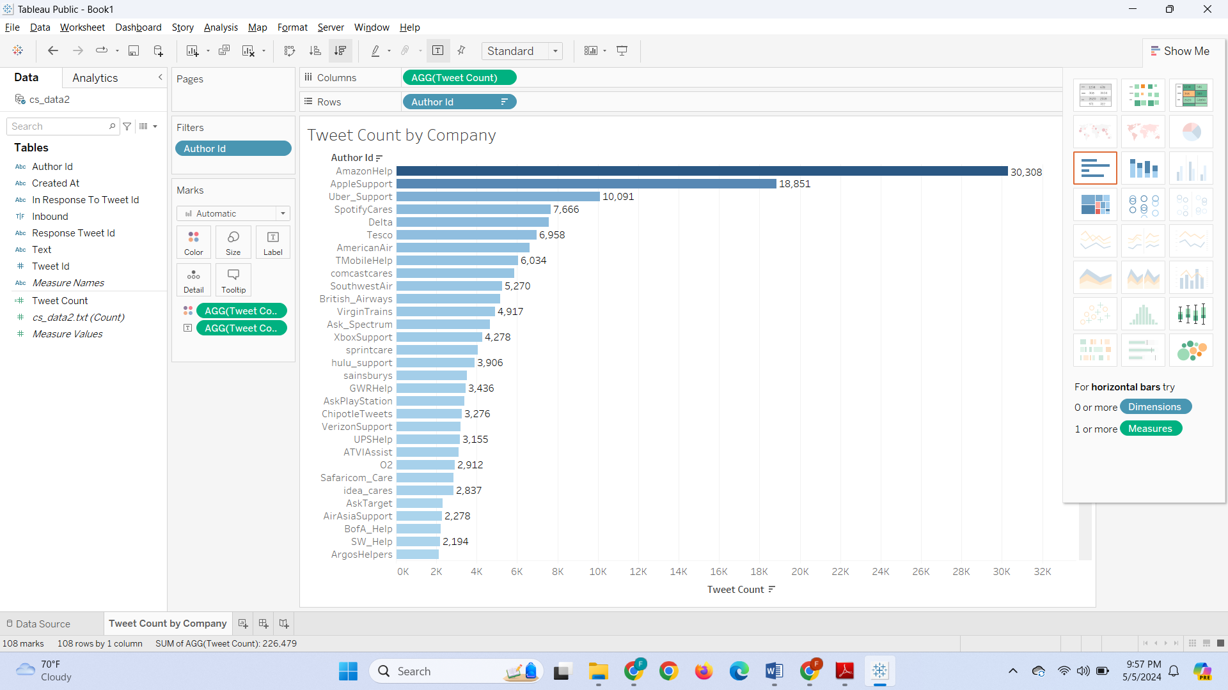
Tweet Count by Company :: Ascending Order
Active company engagement: Many company handles are present, suggesting active customer support on Twitter
Skewed distribution: Few companies contribute significantly more tweets than others

Slide 17
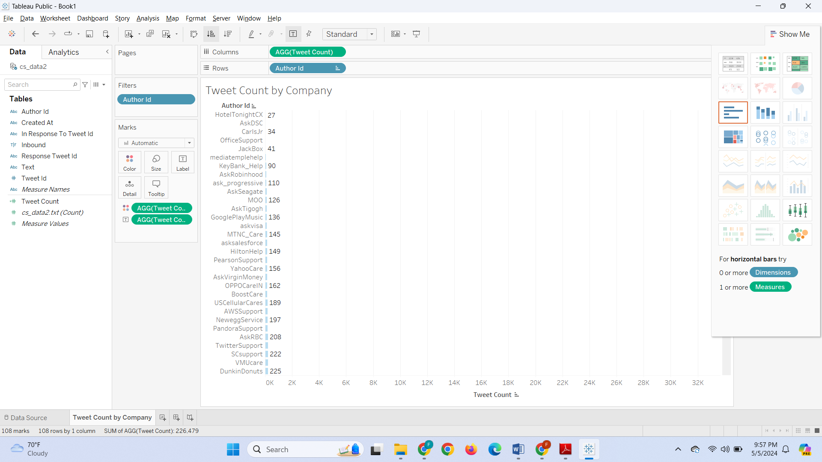
Tweet Count by Company :: Descending Order
Active company engagement: Many company handles are present, suggesting active customer support on Twitter
Reinforcing Skewed distribution: Small companies with very low Tweets

Slide 18
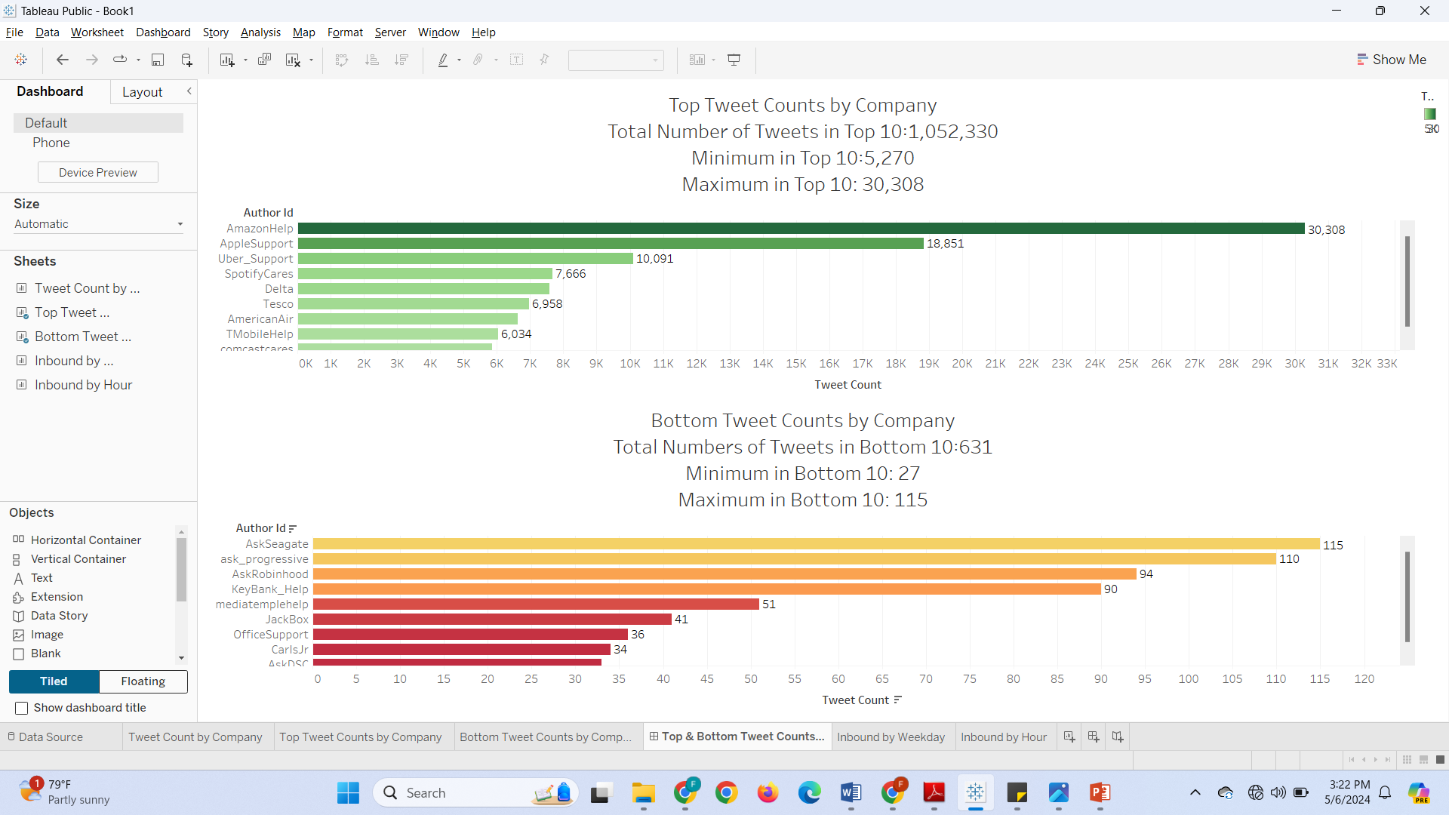
Top vs Bottom Tweet Counts by Companies
Substantial difference in tweet counts between the top and bottom companies

Slide 19
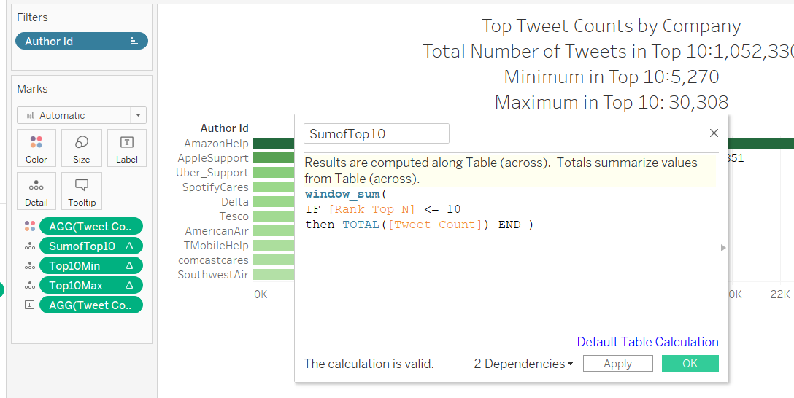
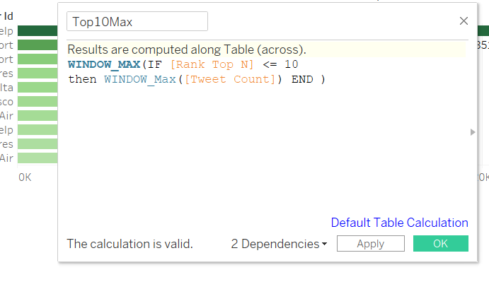
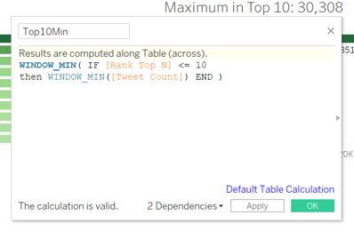
Calculating Sum, Min and Max using window functions:: Top 10
Max within Top 10
Sum of Top 10
Window Functions: Perform dynamic calculations within defined data ranges.
Aggregation: Sum, find minimum, or maximum values over specified windows.
Top 10 Analysis: Essential for identifying top performers and understanding data distribution.
Min within Top 10

Slide 20
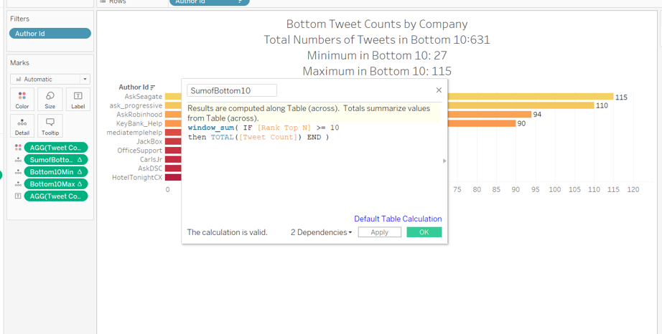
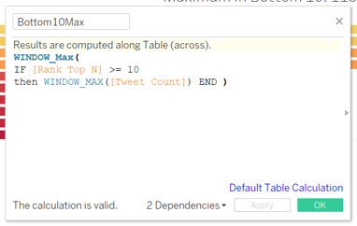
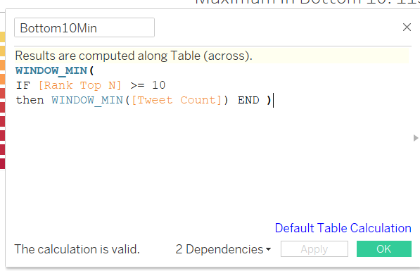
Calculating Sum, Min and Max using window functions:: Bottom 10
Max within Bottom 10
Sum of Bottom 10
Window Functions: Perform dynamic calculations within defined data ranges.
Aggregation: Sum, find minimum, or maximum values over specified windows.
Bottom 10 Analysis: Essential for identifying bottom performers and understanding data distribution.
Min within Bottom 10

Slide 21
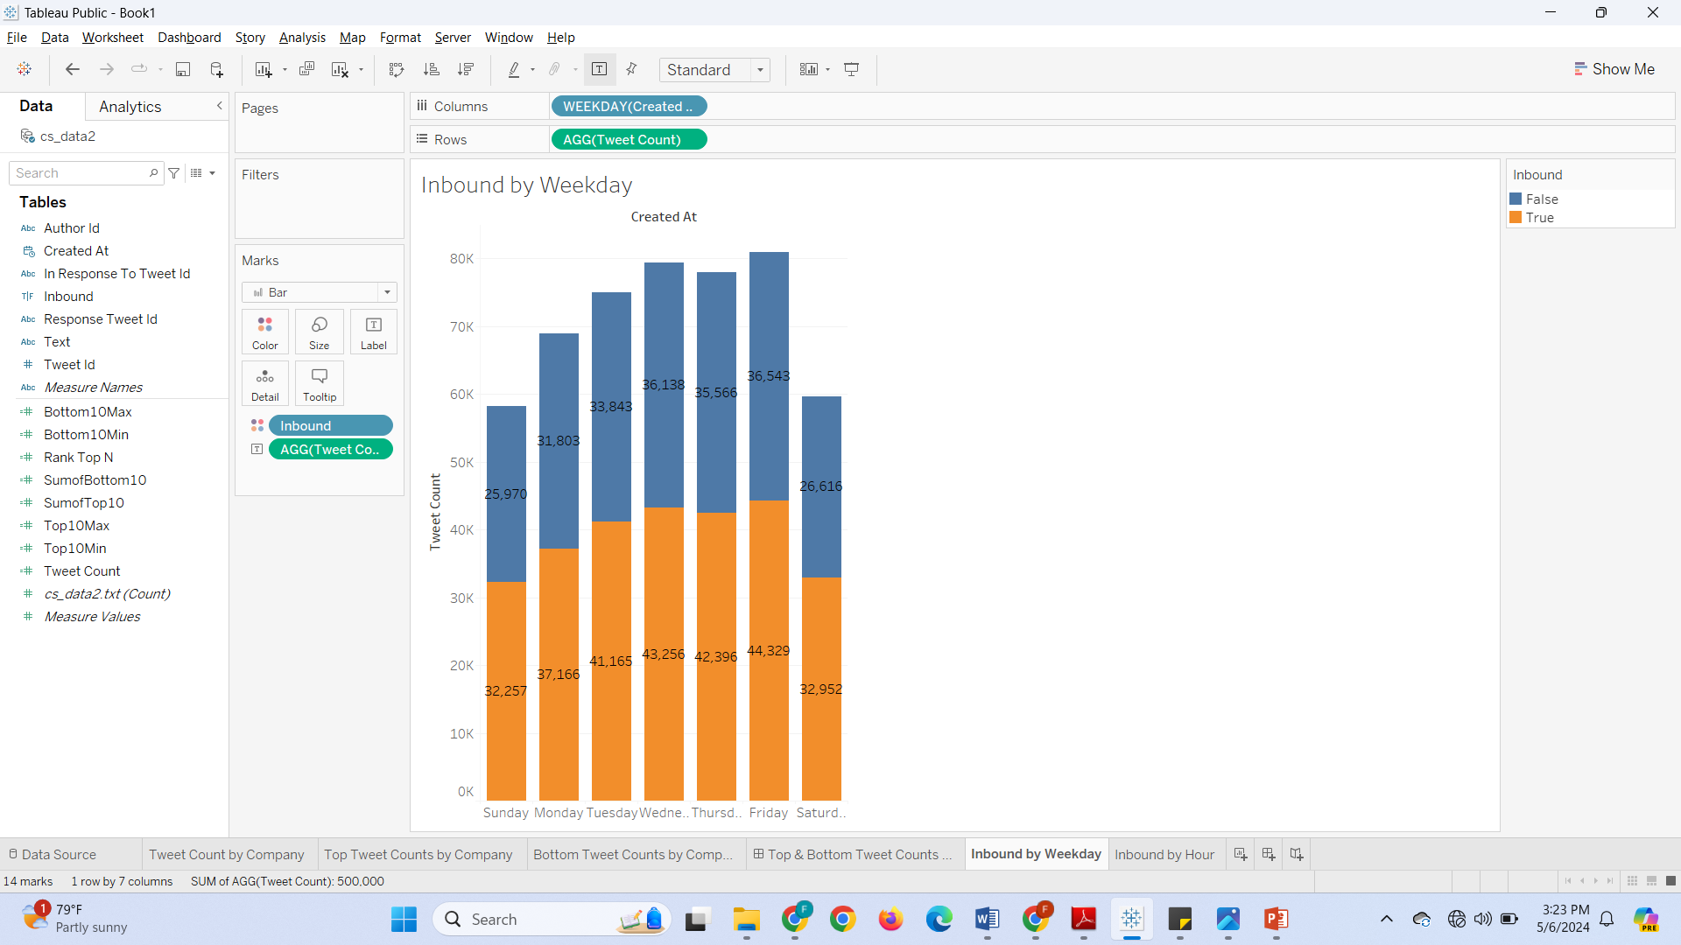
Tweet Count by Company :: Ascending Order
Peak Inbound Calls on Wednesday to Friday
Low frequency on weekends

Slide 22
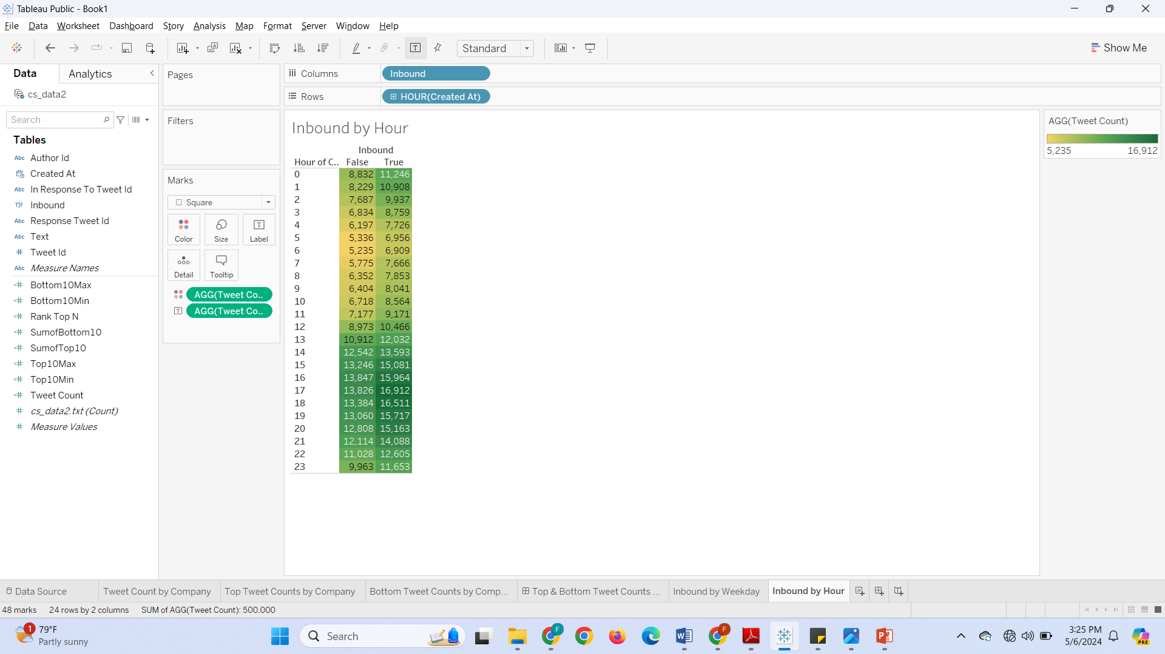
Inbound by Hour
Peaks for both inbound and outbound tweets occur between 13-23 hrs, with lower activity observed from 0-12 hrs

Slide 23
References
R For Loop (w3schools.com)
https://stackoverflow.com/questions/44893354/remove-emoticons-in-r-using-tm-package
r - Remove URLs from string - Stack Overflow
r - Removing non-ASCII characters from data files - Stack Overflow
Save a ggplot (or other grid object) with sensible defaults — ggsave • ggplot2 (tidyverse.org)
https://plotly-r.com/saving
https://community.tableau.com/s/question/0D54T00000C61juSAB/how-to-show-of-total-on-top-n-parameter

Slide 24
Thank You!

